Slide 1
Livy 설치

Slide 2
설치
(in server03)
(livy-python-api 컴파일을 위해서 필요함)
# yum install epel-release
# yum install python-flake8.noarch
# cd /opt
# git clone https://github.com/cloudera/livy.git
# cd livy
# mvn package -DskipTests

Slide 3
실행
(in server03)
# export SPARK_HOME=/opt/cloudera/parcels/CDH/lib/spark
# export HADOOP_CONF_DIR=/etc/hadoop/conf
# mkdir logs
# ./bin/livy-server
...
21/02/25 11:19:08 INFO server.WebServer: Starting server on http://server03.cluster:8998
...

Slide 4
ExecuteSparkInteractive
NiFi 설정

Slide 5
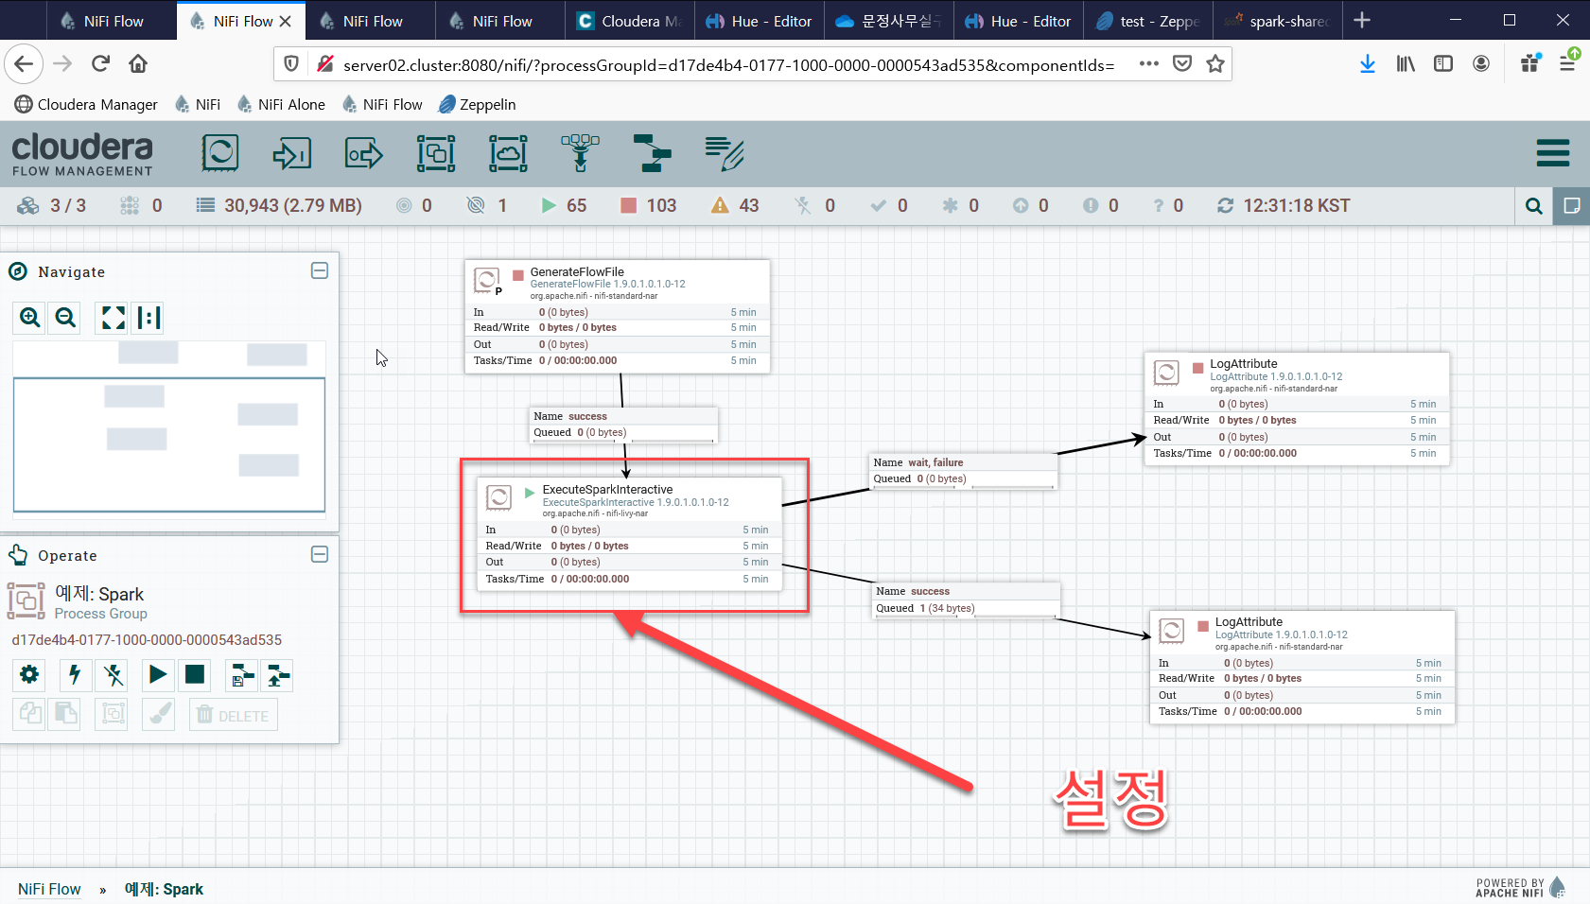

Slide 6
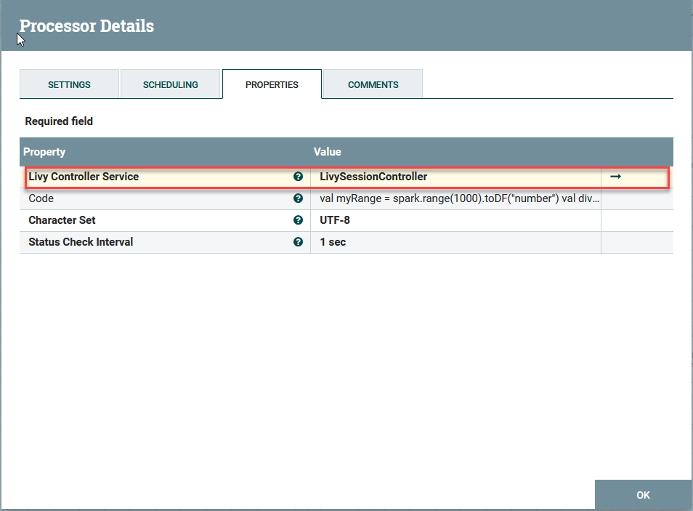
ExecuteSparkInteractive 설정
val myRange = spark.range(1000).toDF("number")
val divisBy2 = myRange.where("number % 2 = 0")
divisBy2.count()

Slide 7
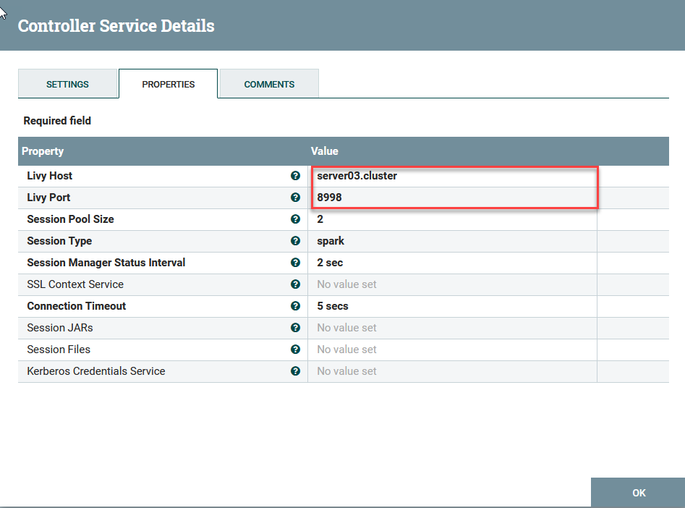
Livy Session Controller 설정

Slide 8
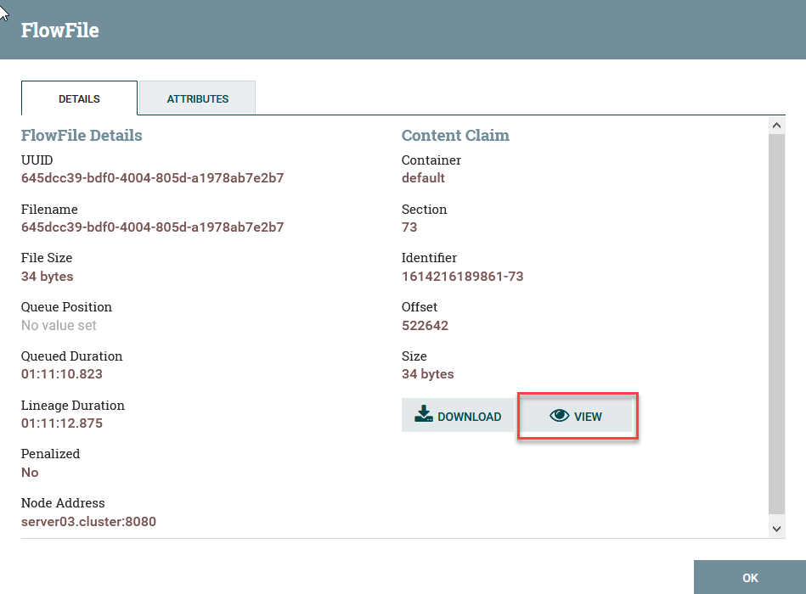
실행 결과 Queue 값 확인

Slide 9
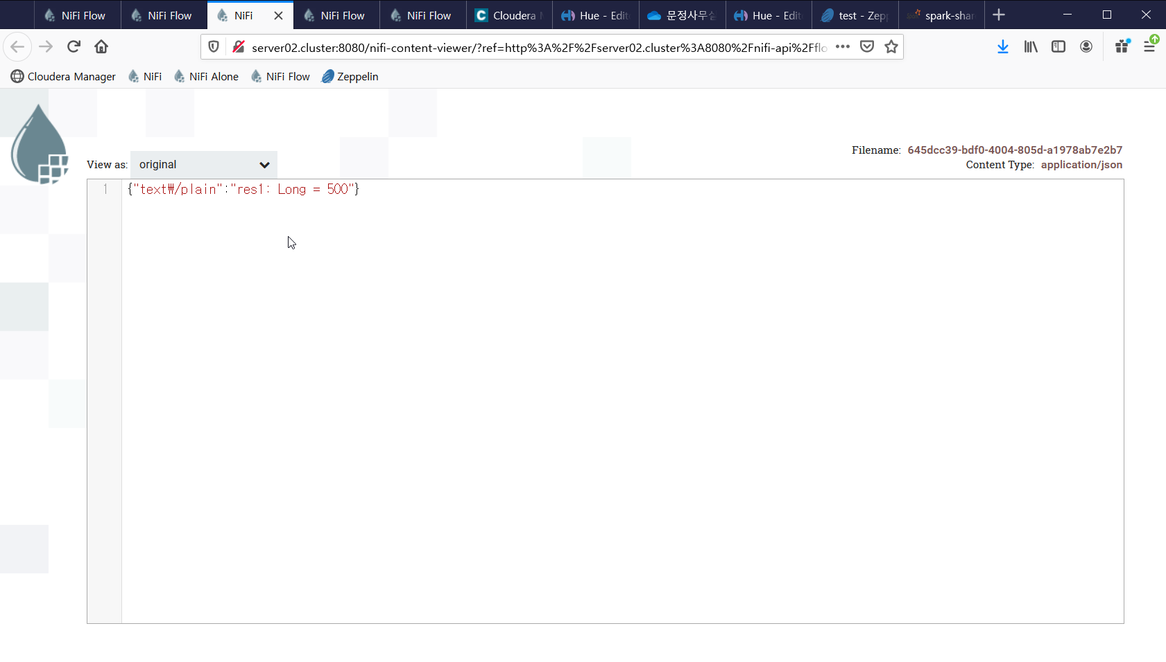
Content 확인

